Slide 1
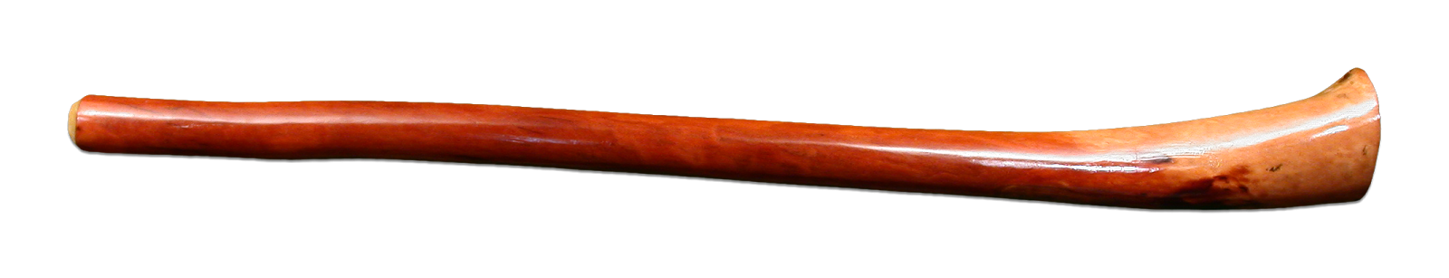
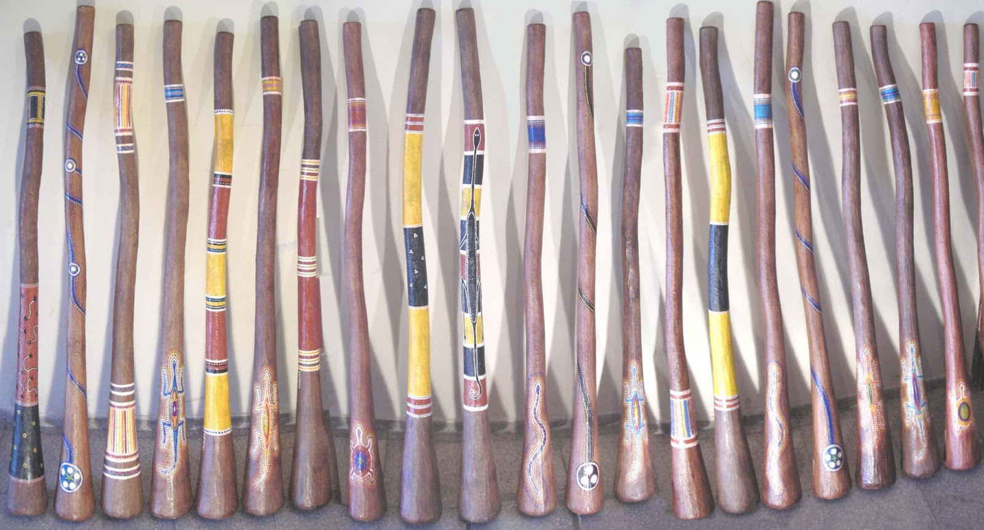
DIDGERIDOO
Darío Fernández ™
2º B ESO

Slide 2
Introduction
Ancient Musical Instrument: The didgeridoo, also known as a yidaki, is a wind instrument developed by Indigenous Australians of northern Australia.
Cultural Significance: Used in various ceremonies and cultural practices, it holds significant spiritual importance in Aboriginal culture.
Unique Sound: Characterized by its deep, resonant sound, the didgeridoo is often described as producing a drone or continuous tone.

Slide 3
History of the Didgeridoo
Ancient Origins: The didgeridoo is believed to be over 1,500 years old, making it one of the world's oldest musical instruments.
Traditional Use: Initially used by Indigenous Australians in ceremonies, storytelling, and spiritual rituals.
Evolution: While the basic design has remained the same, techniques and materials have evolved over centuries.

Slide 4
Cultural Significance
Spiritual Symbol: The didgeridoo is considered a sacred instrument, believed to connect the physical and spiritual worlds.
Ceremonial Use: Used in various ceremonies, including initiation rites, healing rituals, and storytelling.
Symbol of Identity: Represents the cultural identity and heritage of Aboriginal people, symbolizing their connection to the land and ancestors.

Slide 5

Construction of the Didgeridoo
Traditional Materials: Originally made from eucalyptus trees hollowed out by termites.
Modern Materials: Contemporary didgeridoos can be made from a variety of materials including bamboo, agave, and PVC.
Crafting Process: Traditional crafting involves selecting, cutting, and decorating the wood, often with intricate designs.
Unsplash

Slide 6
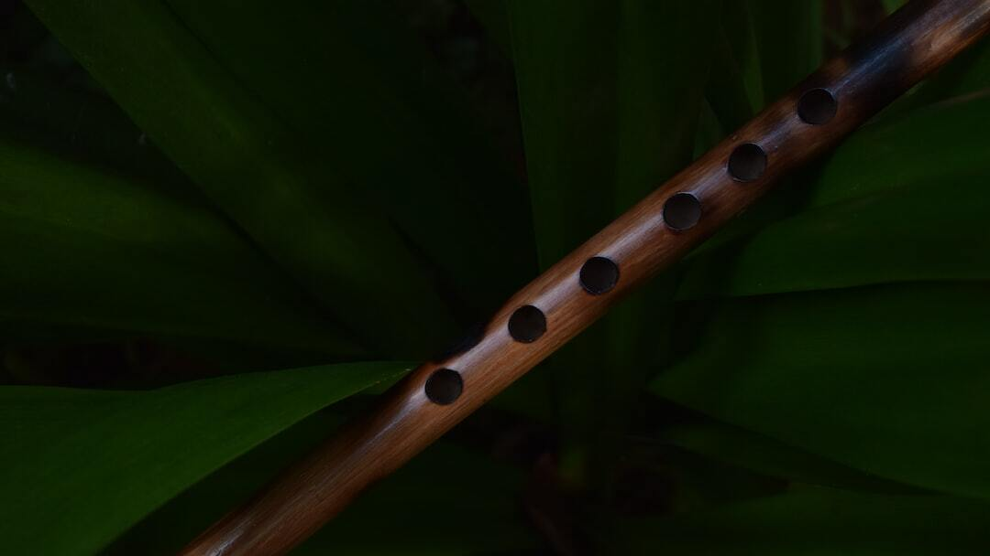
Playing Techniques
Basic Techniques: Involves buzzing the lips and modulating the sound with tongue and mouth movements.
Circular Breathing: A key technique where players breathe in through the nose while simultaneously expelling air through the mouth, allowing for continuous sound production.
Advanced Techniques: Includes vocalizing into the instrument, creating rhythmic patterns, and incorporating various effects to enhance the sound.
Unsplash

Slide 7

Contemporary Use
Fusion with Other Genres: The didgeridoo is increasingly being incorporated into modern music genres like rock, jazz, and electronic music.
Notable Players: Artists like Xavier Rudd and William Barton have popularized the didgeridoo in contemporary music scenes.
Innovative Techniques: Modern players are experimenting with new techniques and electronic modifications to create unique sounds.
Unsplash

Slide 8

Global Influence
International Appeal: The unique sound of the didgeridoo has captivated audiences worldwide, leading to its use in various global music projects.
Cultural Exchange: Workshops and festivals around the world promote cultural exchange and appreciation of Aboriginal traditions.
Integration in Music: Incorporated into diverse musical genres and performances, showcasing its versatility and appeal.
Unsplash

Slide 9
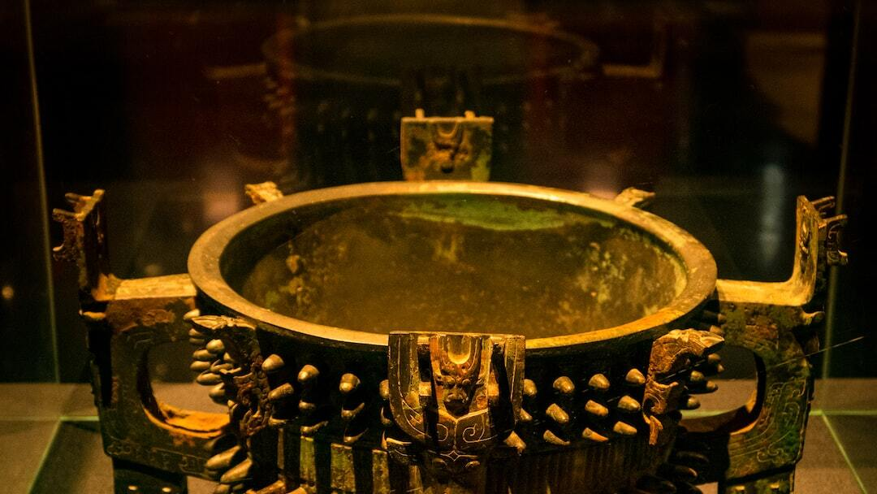
Preservation of Tradition
Cultural Preservation: Efforts are being made to preserve traditional crafting methods and playing techniques of the didgeridoo.
Educational Programs: Workshops and educational programs help to teach the younger generation and interested individuals about the cultural significance and techniques of the didgeridoo.
Cultural Exchange: Promoting understanding and respect through cultural exchange programs that highlight the importance of the didgeridoo in Aboriginal culture.
Unsplash

Slide 10
Conclusion
Continued Evolution: The didgeridoo continues to evolve, with new techniques and styles emerging.
Global Awareness: Increased global awareness and appreciation for the didgeridoo and Aboriginal culture.
Preservation Efforts: Ongoing efforts to preserve traditional knowledge and promote ethical practices.
Photo by Aswin Raj on Unsplash

